Slide 1
Welcome to Community Energy Cumbria’s 7th Annual General Meeting 28th September 2022 6pm.

Slide 2
Agenda
5:50pm: Welcome and technical troubleshooting
6.00pm: Apologies, Minutes of previous AGM & Matters Arising
6.05pm: Review of 2021/22 and update for 2022 so far, Chair
6.20pm: Presentation & adoption of the accounts, Chair
6.25pm: Retirement of and Election of Board of Directors
6.30pm: Motions to be put to AGM
6.50pm: Update on projects funded by Community Benefit Fund
Close of AGM business
6.55pm: Q&A

Slide 3
Solar PV Output Projected Annual Output: 20,159kWh 2017 -2018: 25,448kWh 2018 -2019: 26,542kWh 2019- 2020 : 19,086kWh 2020 – 2021 : 19,036kWh 2021- 2022: 24,701kWh
At March 22 - 122MWh of clean energy since installation

Slide 4
Monthly energy output

Slide 5
Quarterly energy output
Year Apr-Mar | £ per KWh LDNP
16/17
17/18
18/19
19/20 | 0.1133
20/21 | 0.1150
21/22 | 0.1168
22/23 | 0.1273

Slide 6
Hydro Output Projected Annual Output: 152,000kWh 2017 -2018: 131,511kWh (346 days) 2018 -2019: 119,974kWh (379 days) 2019 – 2020: 143,204kWh (360 days) 2020 – 2021: 156,174kWh (366 days) 2021 – 2022: 112,917kWH (362 days)
Since install - 717MWh of clean energy generated saving 167TCo2e to end March 22

Slide 7
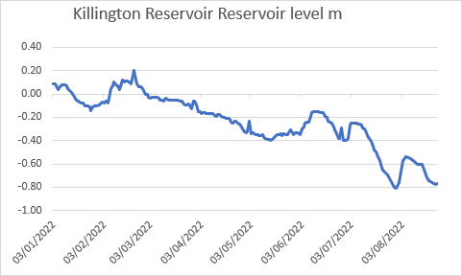
Hydro info
Year Apr-Mar | p per kWh FIT | £ per MWh REGO | £ per MWh export
 | 18.25 |  | £51.10
17/18 |  | £0.50 | £54.07
18/19 |  | £0.50 | £55.97
19/20 |  | £0.50 | £53.13
20/21 | 20.4 | £0.50 | £55
21/22 | 20.6 | £0.50 | £55.70
22/23 | 22.2 | £1.00 | £160.39

Slide 8
Implications of Generation Figures
CEC Income
Interest Payments – 2.5%
Community Benefit Fund - further £2500 to be allocated
Capital Repayments - £15,000 to be returned (applications so far for £3000), plus possible new PV investment.

Slide 9
Presentation & Adoption of the Accounts

Slide 10
Retirement & Election of Board
No new applications received
All board to resign en mass
Propose for all to be re-elected
Vote

Slide 11
Motions to be put to AGM
1. Proposals around the application of profits (community benefit)
In 2018 a motion was agreed that a fund would be set up that:
I) delivers in a geographical radius of 20miles from Killington
II) supports projects that are linked to energy saving /generation
III) supports Cumbria Action for Sustainability (CAfS) to deliver energy projects
Last year, we set aside £2,500 plus underspend from previous years and did not do a call for projects, so a pot of £2870. This year we have a further £2,500. Total pot: £5,370
Proposal: For us to invite applications in line with the above fund parameters.

Slide 12
Proposals continued…
ii. To agree in principle to proceed with investigations into additional solar at the LDNP
iii. to continue with application of section 84 (1) of the Co-operative and Community Benefit Society Act 2014: The Power to disapply audit requirements, whereby our accounts are put for Further Scrutiny by (a) Independent Examiners (b) Board of Directors
iv. any other put forward by members in advance of the meeting
v. that Robinson Udale are appointed as our Auditor/Independent Examiner

