Slide 1

Welcome to Community Energy Cumbria’s 9th Annual General Meeting 4th September 2024 6pm.
Notes:
Apologies: H Hooley, J Meeks
Minutes of previous meeting

Slide 2
Agenda
5:55pm: Welcome and technical troubleshooting
6.00pm: Apologies, Minutes of previous AGM & Matters Arising
6.05pm: Review of 2023/24 and update for 2024 so far, Chair
6.20pm: Update on projects funded by Community Benefit Fund
6.25pm: Presentation & adoption of the accounts, Chair
6.30pm: Retirement of and Election of Board of Directors
6.35pm: Motions to be put to AGM
Close of AGM business
6.50pm:Q&A

Slide 3
Solar PV Output Projected Annual Output: 20,159kWh 2017 -2018: 25,448kWh 2018 -2019: 26,542kWh 2019- 2020 : 19,086kWh 2020 – 2021 : 19,036kWh 2021 – 2022: 24,701 kWh 2022 – 2023: 25,521 kWh 2023-2024: 25,590 kWH = 114 tonnes CO2e to end Mar 24

Slide 4
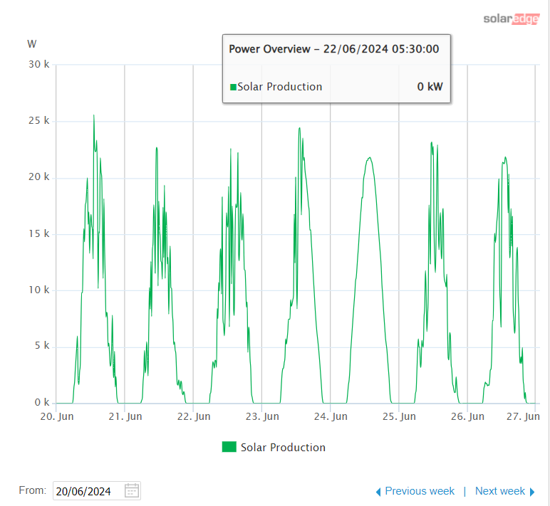
Solar PV snapshot in June 2024

Slide 5
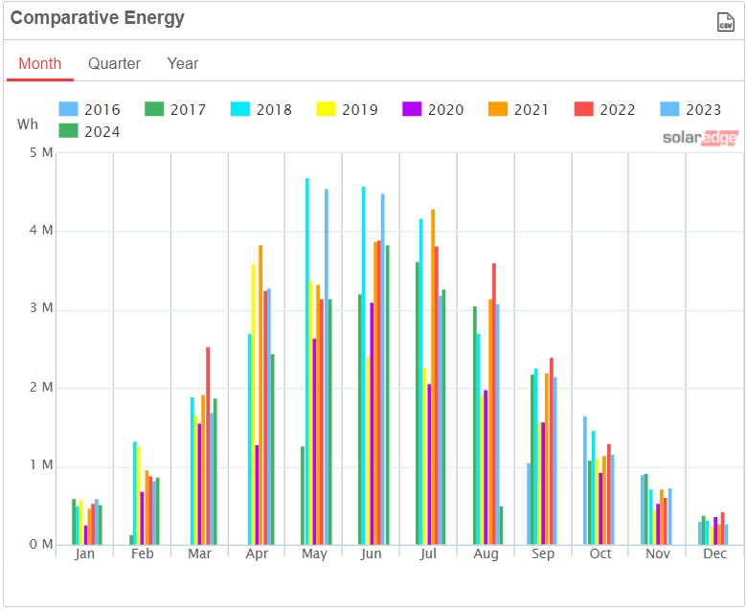
Monthly energy output

Slide 6
Hydro Output Projected Annual Max Output was 152,000kWh
CO2 saved to Mar 2024 = 224 TCO2e

Slide 7
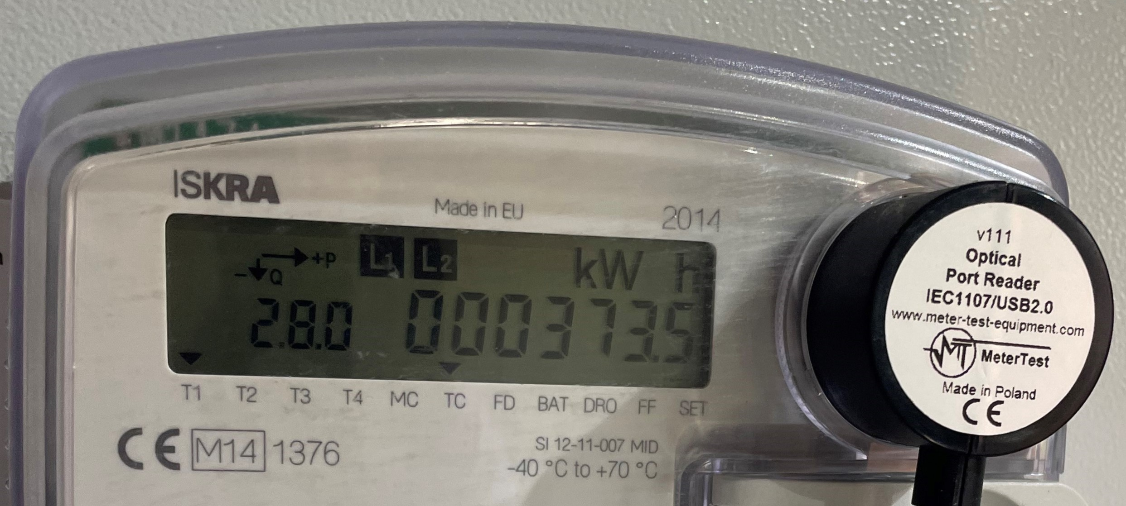
This June 2024 – we clocked the meter !!

Slide 8
Implications of Generation Figures
CEC Income
Interest Payments – 5%
Community Benefit Fund - £2,500 to be set aside
Capital Repayments –c.£30,000 to be returned to investors requesting repayments. No repayments to all members.

Slide 9
Presentation & Adoption of the Accounts

Slide 10

Update on Community Benefit funded projects
Staveley Community Energy hydro project - £2,640 (awarded 2021)
Manna House energy assessment & solar panels - £1,250 (awarded 2021)
Sedbergh Parish council EV chargepoints - £3,000 (awarded 2023)
CAfS CRM implementation - £2,370 (awarded 2023)
Total funds awarded to date: £12,500
Current funds balance £3,240.
Notes:
SCE
- feasibility report on renewing an old hydro has been undertaken, which was positive for the potential costs to renews versus income generated, based on prices paid for kWH generated at the time of the report.
- further studies needed and quotes for the work to be obtained.
MH
- Kendal based charity. Community building used for drop in centre for people in housing need.
- energy audit complete and recommendations started to be implemented, thermal assessment still to be done.
SPC
- small part of £30k project.
I am pleased to advise that the initial phase of civils installation has recently been completed and the Council now await the 2 x new electricity connections required at both car parks. Electricity North West (enwl) are attending Sedbergh next Friday as the next phase - to complete their 'site ready' inspections ahead of the new connections required for the EV chargers. This phase (with enwl) will take several weeks (approx 16+ weeks at Loftus Hill car park) due to the street works notice requirements at both locations. Once the new connections are established, our contractor for the EV Chargers (Eon) will return to complete the meter install and erect the charging units etc.
Whilst it has been a slow process, I am delighted that both installations are now progressing. Please do let me know if you require anything further at this time, the Council are very grateful to all those that are supporting this project for Sedbergh.
CAfS
- contribution towards costs of new CRM to improve communications with supporters, build networks, aim for 25% growth in supporter base. Have been getting demos from companies and are now drafting their requirements ready to go out for prices from preferred suppliers.

Slide 11
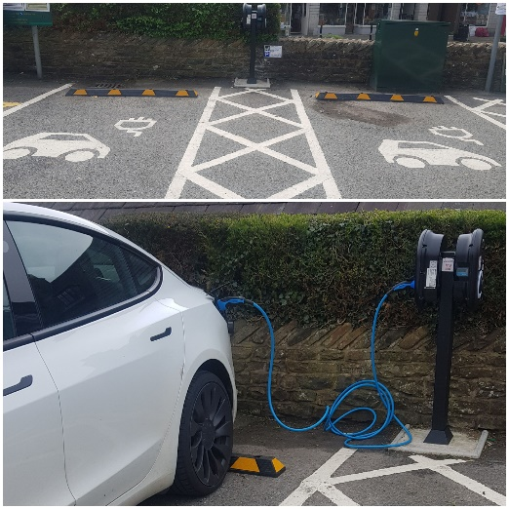
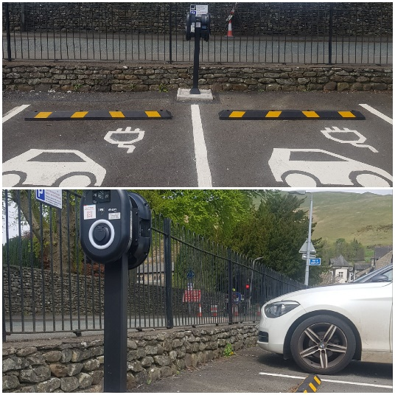
Sedbergh Parish EV Chargers
4 fast 22kW chargers now on ZapMap and National Chargepoint registry
No app needed. Contactless payment.
Installed at Loftus Hill and Joss Lane car parks

Slide 12
Retirement & Election of Board
No new applications received
All board to resign
Propose for all to be re-elected
Vote
Approved

Slide 13
Motions to be put to AGM
1. Proposals around the application of profits (community benefit)
This year we have a further £2,500 to put into the community benefit fund.
Total fund unallocated = £5,740
Director’s proposal is to set this aside and build up to a pot of £8,000 prior to distribution of current funds.
Vote. Approved.

Slide 14
2. Proposals around reinvestment of capital
None

Slide 15
Proposals continued…
to continue with application of section 84 (1) of the Co-operative and Community Benefit Society Act 2014: The Power to disapply audit requirements, whereby our accounts are put for Further Scrutiny by (a) Independent Examiners (b) Board of Directors
Approved
any other put forward by members in advance of the meeting
None
that Robinson Udale are appointed as our Auditor/Independent Examiner
Approved

