Slide 1

Welcome to Community Energy Cumbria’s 10th Annual General Meeting 9th September 2025 6pm.
Notes:
Apologies:
Minutes of previous meeting

Slide 2
Agenda
5:55pm: Welcome and technical troubleshooting
6.00pm: Apologies, Minutes of previous AGM & Matters Arising
6.05pm: Review of 2024/25 and update for 2025 so far, Chair
6.20pm: Update on projects funded by Community Benefit Fund
6.25pm: Presentation & adoption of the accounts, Chair
6.30pm: Retirement of and Election of Board of Directors
6.35pm: Motions to be put to AGM
6.45pm: Close of AGM business, Member Q&A
7pm: End
Notes:
Apologies – R Yates
Minutes of previous AGM.

Slide 3
Solar PV Output Projected Annual Output: 20,159kWh 2017/18: 25,448 kWh 2018/19: 26,542 kWh 2019/20: 19,086 kWh 2020/21: 19,036 kWh 2021/22: 24,701 kWh 2022/23: 25,521 kWh 2023/24: 25,590 kWh 2024 /25: 23,864 kWh = 49 tonnes CO2e saved to date

Slide 4
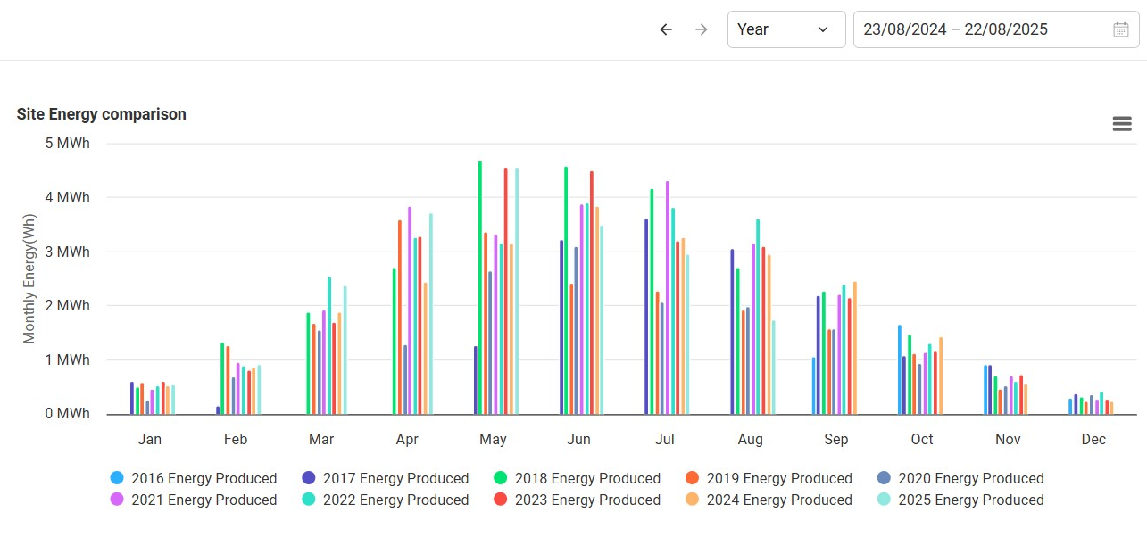
PV annual energy comparison

Slide 5
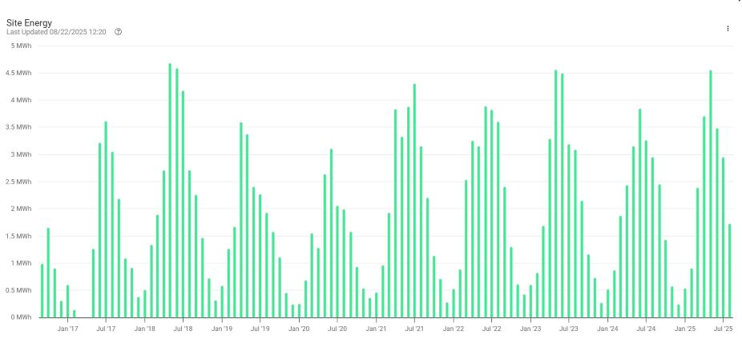
PV historic output

Slide 6
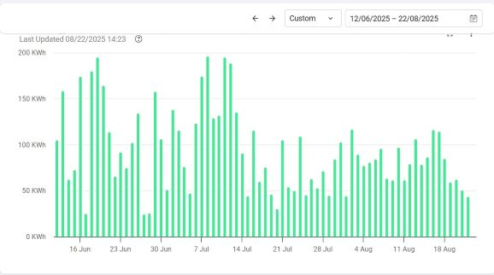
PV – last few months

Slide 7
Killington Annual kWh generation
Projected annual generation was 152,000 kWH
Year | Annual kWh | Days | Av. kWh/day
16/17 | 53785 | 145 | 371
17/18 | 131511 | 346 | 380
18/19 | 119974 | 379 | 317
19/20 | 143204 | 360 | 398
20/21 | 156174 | 366 | 427
21/22 | 112917 | 362 | 312
22/23 | 105412 | 373 | 283
23/24 | 138541 | 350 | 396
24/25 | 131398 | 370 | 355

Slide 8
Hydro Output Projected Annual Max Output was 152,000kWh
Cumulative CO2e saved to Mar 2025 = 255 TCO2e
£44,304

Slide 9
Implications of Generation Figures
CEC Income
Interest Payments – 5%
Community Benefit Fund - £2,500 can be set aside
Capital Repayments –c.£10,000 to be returned to investors requesting repayments. Plus 5% of investments c. £15,000 repayments to be split across all members.
Other – Board capacity – update members on discussions

Slide 10

Update on Community Benefit funded projects
Total funds awarded to date: £12,500
No funds awarded since last grant round in 2023
Current funds balance: £8,240.
Projects supported:
CAfS | CAfS Cumbria Green Build & Sustainable Living Festival contribution to S Lakes events
Manna House | Energy Audit & thermal imaging assessment
Staveley Community Energy CIC | Advice and capacity to move Staveley Mill hydro forward
Sedbergh Parish Council | Funding towards EV chargepoint project
CAfS | CRM implementation costs
Notes:
SCE
- feasibility report on renewing an old hydro has been undertaken, which was positive for the potential costs to renews versus income generated, based on prices paid for kWH generated at the time of the report.
- further studies needed and quotes for the work to be obtained.
MH
- Kendal based charity. Community building used for drop in centre for people in housing need.
- energy audit complete and recommendations started to be implemented, thermal assessment still to be done.
SPC
- small part of £30k project.
I am pleased to advise that the initial phase of civils installation has recently been completed and the Council now await the 2 x new electricity connections required at both car parks. Electricity North West (enwl) are attending Sedbergh next Friday as the next phase - to complete their 'site ready' inspections ahead of the new connections required for the EV chargers. This phase (with enwl) will take several weeks (approx 16+ weeks at Loftus Hill car park) due to the street works notice requirements at both locations. Once the new connections are established, our contractor for the EV Chargers (Eon) will return to complete the meter install and erect the charging units etc.
Whilst it has been a slow process, I am delighted that both installations are now progressing. Please do let me know if you require anything further at this time, the Council are very grateful to all those that are supporting this project for Sedbergh.
CAfS
- contribution towards costs of new CRM to improve communications with supporters, build networks, aim for 25% growth in supporter base. Have been getting demos from companies and are now drafting their requirements ready to go out for prices from preferred suppliers.

Slide 11
Presentation & Adoption of the Accounts

Slide 12
Retirement & Election of Board
No new applications received
All board to resign
Propose for all to be re-elected
Vote:

Slide 13
Motions to be put to AGM
1. Proposals around the application of profits (community benefit)
This year we have a further £2,500 to put into the community benefit fund.
Total fund unallocated = £8,240
Director’s proposal is to ask for applications to the funds.
Vote:

Slide 14
Proposals continued…
2. Proposals around reinvestment of capital
None
to continue with application of section 84 (1) of the Co-operative and Community Benefit Society Act 2014: The Power to disapply audit requirements, whereby our accounts are put for Further Scrutiny by (a) Independent Examiners (b) Board of Directors
Vote:
any other put forward by members in advance of the meeting
None submitted
that Robinson Udale are appointed as our Auditor/Independent Examiner
Vote:

Slide 15

AGM Close

